Slide 1
Online Examination System

Slide 2
Motivation for choosing the project
To create a scalable and highly available application using AppSync, React GraphQL.
GraphQL is a technology designed by Facebook for mordern application design.
Agile for evolving apps.
Standard for Web APIs.

Slide 3
Project Goal
To create a scalable and highly available Online Examination System using AppSync, React and GraphQL.
Instead of spending time building EC2 instances, setting up containers or deploying Lambda functions we can create schema for AppSync and focus on frontend for our website.

Slide 4
Project Description
It’s a Quiz App where users can answer the questions and get live updates as other users create quizzes.
Created user accounts using Cognito.
Local storage/caching is done by DynamoDB.
To deploy this we have used amplify CLI tool which will deal with our code as well as AWS services beside it can scale up or down no matter how much is demand.

Slide 5
Limitation of Existing Projects
NPTEL examination system runs on servers which are present in either of IIT’s. Nowadays most students prefer to give examination depending upon there preparation stratergy and don’t want to get tied with the time.(e.g. RedHat certifications, AWS certifications, Azure Certifications). Now in this case of NPTEL result into unexpected traffic on the server( means server capacity either get wasted or can’t fulfill the requirement at that particular time)(if they try to adopt this strategy).

Slide 6
Innovation in Project
If we were building this in Traditional Architecture we might need bunch of different components like:
Load Balancer
Application Cluster
Job/Task Service
Database
CDN
Appsync takes lot of the components that we
have to manage and makes them AWS concerns.
We are still responsible for writing application side

Slide 7
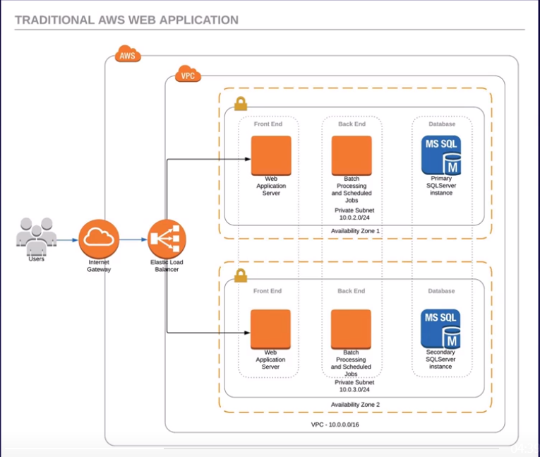


Slide 8
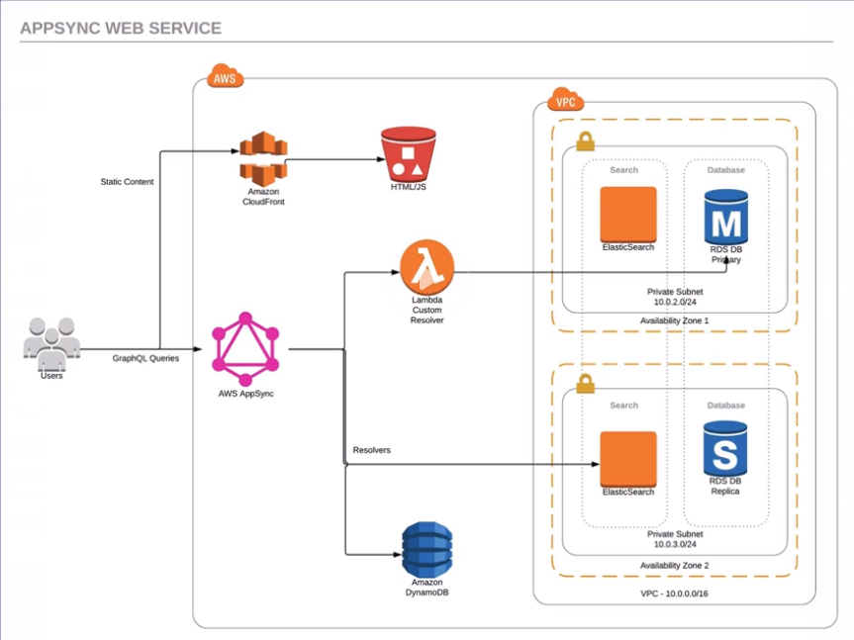

Slide 9
AppSync Components
An API is all the components behind an endpoint. AppSync provides an HTTPS endpoint.
A DataSource is any of the AppSync-supported providers for user data, such as DynamoDB or ElasticSearch(via Lambda).
A Resolver is a transformation written using Velocity template Language(VTL) that changes the output from a data source to match the output of the Schema.

Slide 10
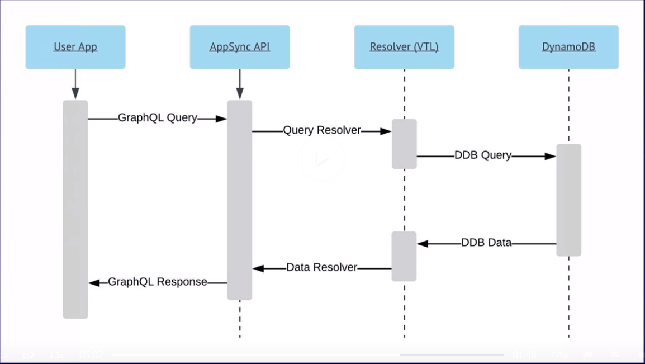
Official AWS Process diagram for Appsync:

Slide 11
Simple GraphQL Query
{
  getGames{
  title
  ratings
  comments {
  text
  commenter { name profilePic }
  }
  }
  }

Slide 12
Software Libraries/Services
AWS amplify includes CLI tools.
AWS Cognito include social auth, user data sync for password and Oauth 2.0 apps
AWS AppSync : providing data source integration to build powerful GraphQL queries.

Slide 13
Other Tools:
Lambda
Cognito
API Gateway
AppSync : Mobile and Web Applications needs to communicate via HTTPS to our endpoints, and API Gateway allows you to connect API calls to Lambda Function.
DynamoDB
SNS/PinPoint

Slide 14
Test cases designed to test at the end
Will large number of users be able to use application simultaneously?
Ans: Yes
Will it provide only Authenticated user to either create a quiz or attempt a quiz.
Ans: Yes
Do I need to manage servers or watch for the APIs(REST, SOAP, etc) format while quering or demanding something on search system ?
Ans: No, Appsync will create a Resolver which provides you the VTL which will deal with the APIs and other AWS Services.

Slide 15
List of Functional Requirements:
Here user will get Sign In and Sign Up Option.
Once Logged into the respective account they can attempt any quizzes mentioned in the drop down option.
User can know their score at the bottom of the app or the website.
If users is given a specific rights he/she can create their own quizzes too!

Slide 16
List of Non-Functional Requirements:
Accesibility : Any web browser or Mobile Devices.
Usability : Users will be able to quiz themselves by simply signing up.
Availability: This application will be having the highest availability than any present online exam system ( As it’s Serverless).
Performance: High performance with Low Latency(as it also uses CDN CloudFront). Even if thousands or lakhs of user expect to show up for a particular examination at particular time of that day applications unexpected traffic won’t be a problem as AppSync and Lambda will manage all the backend infrastructure of managing and scaling of server.
Extensibility: Uses GraphQL so restriction to particular language domain won’t be a problem. User can query anything with which they are suitable and that will be converted to appropriate query language according to the backend database used (here DynamoDB) with the help of Resolver which uses Velocity Template Language(VTL).

Slide 17
Learning Outcome
Learn how to write GraphQL query which will be the future of querying languages.
How to use AppSync to prevent all unnecessary API managements and all stuff.
How to create a serverless application which will be the future of the all upcoming projects.

